Slide 1
Lecture 7
Matrices
CSCI – 1900 Mathematics for Computer Science
Fall 2014
Bill Pine

Slide 2
Lecture Introduction
Reading
  Rosen - Section 2.6
Definition of a matrix
Examine basic matrix operations
  Addition
  Multiplication
  Transpose
Bit matrix operations
  Meet
  Join
Matrix Inverse

Slide 3
Matrix M by N
Matrix – a rectangular array of numbers arranged in m horizontal rows and n vertical columns, enclosed in square brackets
We say A is a m by n matrix, written as m x n
a₁₁ a₁₂ a₁₃ . . . a_{1n}
a₂₁ a₂₂ a₂₃ . . . a_{2n}
A = . . .
. . .
a_{m1} a_{m2} a_{m3} a_{mn}

Slide 4
Matrix Example
Let A = 1 3 5
  2 -1 0
A has 2 rows and 3 columns
  A is a 2 x 3 matrix
First row of A is [1 3 5]
The second column of A is 3
-1

Slide 5
Matrix
If m = n, then A is a square matrix of size n
The main diagonal of a square matrix A is a₁₁ a₂₂ … a_{nn}
If every entry off the main diagonal is zero, i.e. a_{ik} = 0 for i ≠ k, then A is a diagonal matrix
3 | 2 | 6 | 5 | 9 | 4 | 2
0 | 1 | 0 | 0 | 0 | 0 | 3
0 | 0 | 4 | 0 | 0 | 0 | 4
6 | 6 | 0 | 1 | 0 | 0 | 7
0 | 0 | 0 | 0 | 5 | 0 | 8
0 | 0 | 6 | 2 | 2 | 6 | 8
0 | 0 | 0 | 0 | 0 | 0 | 9
3 | 0 | 0 | 0 | 0 | 0 | 0
0 | 1 | 0 | 0 | 0 | 0 | 0
0 | 0 | 4 | 0 | 0 | 0 | 0
0 | 0 | 0 | 1 | 0 | 0 | 0
0 | 0 | 0 | 0 | 5 | 0 | 0
0 | 0 | 0 | 0 | 0 | 6 | 0
0 | 0 | 0 | 0 | 0 | 0 | 9
3 | 2 | 6 | 5 | 9 | 4 | 2
0 | 1 | 0 | 0 | 0 | 0 | 3
0 | 0 | 4 | 0 | 0 | 0 | 4
6 | 6 | 0 | 1 | 0 | 0 | 7
0 | 0 | 0 | 0 | 5 | 0 | 8
0 | 0 | 6 | 2 | 2 | 6 | 8
0 | 0 | 0 | 0 | 0 | 0 | 9
m = n = 7 square matrix and diagonal

Slide 6
Special Matrices
Identity matrix – a diagonal matrix with 1’s on the diagonal; zeros elsewhere
Zero matrix – matrix of all 0’s
1 | 0 | 0 | 0
0 | 1 | 0 | 0
0 | 0 | 1 | 0
0 | 0 | 0 | 1
0 | 0 | 0 | 0
0 | 0 | 0 | 0

Slide 7
Matrix Equality
Two matrices A and B are equal when all corresponding elements are equal
  A = B when a_{ik} = b_{ik} for all i, k
  1 ≤ i ≤ m, 1 ≤ k ≤ n

Slide 8
Sum of Two Matrices
To add two matrices, they must be the same size
  Each position in the resultant matrix is the sum of the corresponding positions in the original matrices
Properties
  A+B = B+A
  A+(B+C) = (A+B)+C
  A+0 = 0+A (0 is the zero matrix)

Slide 9
Sum Example
A
B
Result
2 | 12
8 | 10
6 | 4
13 | 6
8 | 9
11 | 16
+
=

Slide 10
Sum Row 1 Col 1
A
B
Result
2 | 12
8 | 10
6 | 4
13 | 6
8 | 9
11 | 16
15
+
=
2 + 13 = 15

Slide 11
Sum Row 1 Col 2
A
B
Result
2 | 12
8 | 10
6 | 4
13 | 6
8 | 9
11 | 16
15 | 18
+
=
12 + 6 = 18

Slide 12
Sum Row 2 Col 1
A
B
Result
2 | 12
8 | 10
6 | 4
13 | 6
8 | 9
11 | 16
15 | 18
16
+
=
8 + 8 = 16

Slide 13
Sum - Complete
A
B
Result
2 | 12
8 | 10
6 | 4
13 | 6
8 | 9
11 | 16
15 | 18
16 | 19
17 | 20
+
=
4 + 16 = 20

Slide 14
Product of Two Matrices
If A is a m x k matrix, then multiplication is only defined for B which is a k x n matrix
  The result is an m x n matrix
  If A is 5 x 3, then B must be a 3 x k matrix for any number k >0
  If A is a 56 x 31 and B is a 31 x 10, then the product AB will by a 56 x 10 matrix
Let C = AB, then c₁₂ is calculated using the first row of A and the second column of B

Slide 15
Product Example 1
Example: Multiply a 3 x 2 matrix by a 2 x 3 matrix
  The product is a 3 by 3 matrix
2 | 8
4 | 10
6 | 12
3 | 5 | 7
9 | 11 | 13

Slide 16
Product Example 1
A
B
Result
2 | 8
4 | 10
6 | 12
3 | 5 | 7
9 | 11 | 13
*
=

Slide 17
Product Row 1 Col 1
A
B
Result
2 | 8
4 | 10
6 | 12
78
3 | 5 | 7
9 | 11 | 13
*
=
2 * 3 + 8 * 9 = 78

Slide 18
Product Row 1 Col 2
A
B
Result
2 | 8
4 | 10
6 | 12
78 | 98
3 | 5 | 7
9 | 11 | 13
*
=
2 * 5 + 8 * 11 = 98

Slide 19
Product Row 1 Col 3
A
B
Result
2 | 8
4 | 10
6 | 12
78 | 98 | 118
3 | 5 | 7
9 | 11 | 13
*
=
2 * 7 + 8 * 13 = 118

Slide 20
Product Row 2 Col 1
A
B
Result
2 | 8
4 | 10
6 | 12
78 | 98 | 118
102
3 | 5 | 7
9 | 11 | 13
*
=
4 * 3 + 10 * 9 = 102

Slide 21
Product - Complete
A
B
Product
2 | 8
4 | 10
6 | 12
78 | 98 | 118
102 | 130 | 158
126 | 162 | 198
3 | 5 | 7
9 | 11 | 13
*
=
6 * 7 + 12 * 13 = 198

Slide 22
Product Example 2
Let’s look at a 4 by 2 matrix and a 2 by 3 matrix Their product is a 4 by 3 matrix
2 | 8
4 | 10
6 | 12
5 | 3
3 | 5 | 7
9 | 11 | 13

Slide 23
Product Example 2
A
B
Product
2 | 8
4 | 10
6 | 12
5 | 3
3 | 5 | 7
9 | 11 | 13
*
=

Slide 24
Product Row 1 Col 1
A
B
Product
2 | 8
4 | 10
6 | 12
5 | 3
78
3 | 5 | 7
9 | 11 | 13
*
=
2 * 3 + 8 * 9 = 78

Slide 25
Product Row 1 Col 2
A
B
Product
2 | 8
4 | 10
6 | 12
5 | 3
78 | 98
3 | 5 | 7
9 | 11 | 13
*
=
2 * 5 + 8 * 11 = 98

Slide 26
Product Row 1 Col 3
A
B
Product
2 | 8
4 | 10
6 | 12
5 | 3
78 | 98 | 118
3 | 5 | 7
9 | 11 | 13
*
=
2 * 7 + 8 * 13 = 118

Slide 27
Product Row 2 Col 1
A
B
Product
2 | 8
4 | 10
6 | 12
5 | 3
78 | 98 | 118
102
3 | 5 | 7
9 | 11 | 13
*
=
4 * 3 + 10 * 9 = 102

Slide 28
Product - Complete
A
B
Product
2 | 8
4 | 10
6 | 12
5 | 3
78 | 98 | 118
102 | 130 | 158
126 | 162 | 198
42 | 58 | 74
3 | 5 | 7
9 | 11 | 13
*
=
5 * 7 + 3 * 13 = 74

Slide 29
Summary of Matrix Multiplication
In general, AB ≠ BA
  BA may not even be defined
Properties
  A(BC)=(AB)C
  A(B+C)=AB+AC
  (A+B)C=AC+BC

Slide 30

Boolean (Bit Matrix)
Each element is either a 0 or a 1
Very common in CS
Easy to manipulate
$$\left[\begin{matrix}1 & 0 & 1 \\ 0 & 0 & 1 \\ 1 & 1 & 1 \\ 0 & 0 & 0\end{matrix}\right]$$

Slide 31
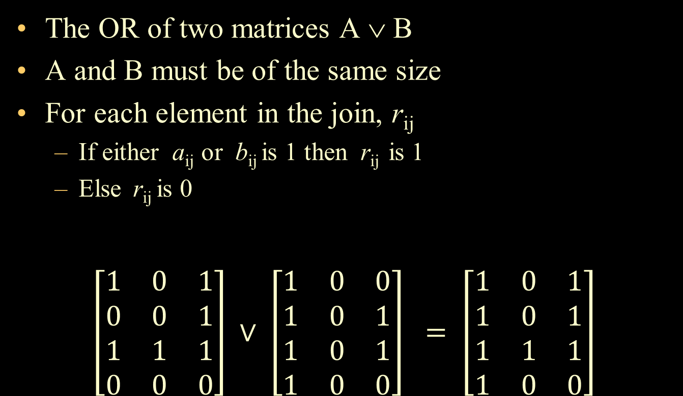
Join of Bit Matrices (OR)
The OR of two matrices A ∨ B
A and B must be of the same size
For each element in the join, r_{ij}
  If either a_{ij} or b_{ij} is 1 then r_{ij} is 1
  Else r_{ij} is 0
$\left[\begin{matrix}1 & 0 & 1 \\ 0 & 0 & 1 \\ 1 & 1 & 1 \\ 0 & 0 & 0\end{matrix}\right] ∨ \left[\begin{matrix}1 & 0 & 0 \\ 1 & 0 & 1 \\ 1 & 0 & 1 \\ 1 & 0 & 0\end{matrix}\right] = \left[\begin{matrix}1 & 0 & 1 \\ 1 & 0 & 1 \\ 1 & 1 & 1 \\ 1 & 0 & 0\end{matrix}\right]$
A
B
R
1 | 0 | 1
0 | 0 | 1
1 | 1 | 1
0 | 0 | 0
1 | 0 | 0
1 | 0 | 1
1 | 0 | 1
1 | 0 | 0
1 | 0 | 1
1 | 0 | 1
1 | 1 | 1
1 | 0 | 0
∨
=

Slide 32
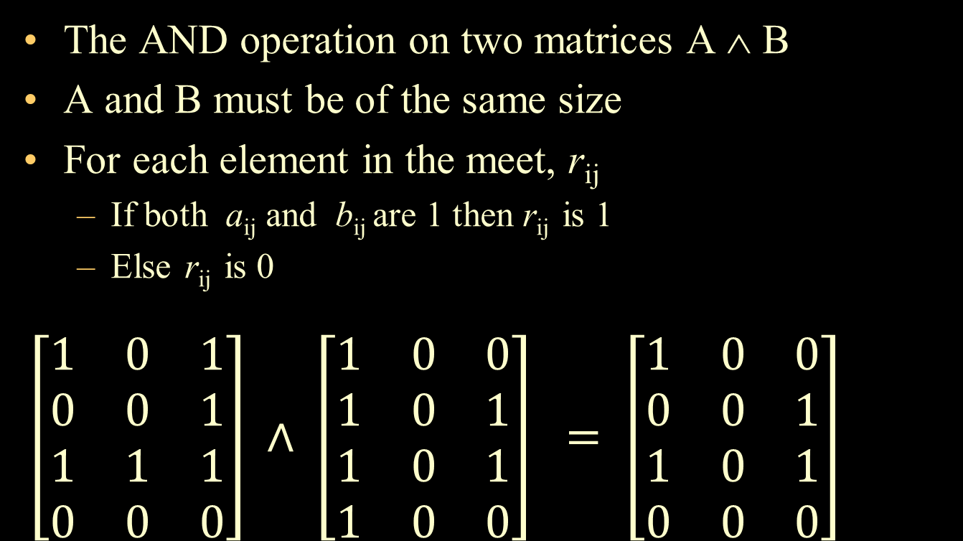
Meet of Bit Matrices (AND)
The AND operation on two matrices A ∧ B
A and B must be of the same size
For each element in the meet, r_{ij}
  If both a_{ij} and b_{ij} are 1 then r_{ij} is 1
  Else r_{ij} is 0
$\left[\begin{matrix}1 & 0 & 1 \\ 0 & 0 & 1 \\ 1 & 1 & 1 \\ 0 & 0 & 0\end{matrix}\right] ∧ \left[\begin{matrix}1 & 0 & 0 \\ 1 & 0 & 1 \\ 1 & 0 & 1 \\ 1 & 0 & 0\end{matrix}\right] = \left[\begin{matrix}1 & 0 & 0 \\ 0 & 0 & 1 \\ 1 & 0 & 1 \\ 0 & 0 & 0\end{matrix}\right]$
A
B
R
1 | 0 | 1
0 | 0 | 1
1 | 1 | 1
0 | 0 | 0
1 | 0 | 0
1 | 0 | 1
1 | 0 | 1
1 | 0 | 0
1 | 0 | 0
0 | 0 | 1
1 | 0 | 1
0 | 0 | 0
∧
=

Slide 33
Transpose
The transpose of A, denoted A^{T}, is obtained by interchanging the rows and columns of A
Example
1 3 5 T = 1 2
  2 -1 0 3 -1
  5 0

Slide 34
Transpose (cont)
(A^{T})^{T}=A
(A+B)^{T} = A^{T}+B^{T}
(AB)^{T} = B^{T}A^{T}
If A^{T}=A, then A is symmetric

Slide 35
Inverse
If A and B are n x n matrices and AB=I, we say B is the inverse of A
The inverse of a matrix A, denoted A⁻¹
It is not possible to define an inverse for every matrix

Slide 36

Inverse Matrix Example
$\left[\begin{matrix}1 & 0 & 2 \\ 2 & −1 & 3 \\ 4 & 1 & 8\end{matrix}\right] ∗ \left[\begin{matrix}−11 & 2 & 2 \\ −4 & 0 & 1 \\ 6 & −1 & −1\end{matrix}\right] = \left[\begin{matrix}1 & 0 & 0 \\ 0 & 1 & 0 \\ 0 & 0 & 1\end{matrix}\right]$
R1 C1: 1*-11 + 0* -4 + 2*6 = 1
R1 C2: 1*2 + 0*0 + 2*-1 = 0
R1 C3: 1*2 + 0*1 + 2*-1 = 0
R2 C1: 2*-11 + -1* -4 + 3*6 = 0
R2 C2: 2*2 + -1* 0 + 3*-1 = 1
R2 C3: 2*2 + -1* 1 + 3*-1 = 0
R3 C1: 4*-11 + 1* -4 + 8*6 = 0
R3 C2: 4*2 + 1*0 + 8*-1 = 0
R3 C3: 4*2 + 1* 1 + 8*-1 = 1

Slide 37
Key Concepts Summary
Definition of a matrix
Examine basic matrix operations
  Addition
  Multiplication
  Transpose
Bit matrix operations
  Meet
  Join
Matrix Inverse

